Slide 1
java -versionopenjdk version "1.8.0_462"IBM Semeru Runtime Open Edition (build 1.8.0_462-b08)Eclipse OpenJ9 VM (build openj9-0.53.0, JRE 1.8.0 Linux amd64-64-Bit Compressed References 20250722_1282 (JIT enabled, AOT enabled)OpenJ9
017819f167OMR - 266a8c6f5JCL
cb4b9ae56e based on jdk8u462-b08)
HAProxy recebe HTTP1 e converte para HTTP/2
HAProxy
Liberty
AppLogon
HotRodCacheAdaptaer
Jmeter
HTTP/1
WAF
GA (Global Acelerator)
ALB
HAProxy
Liberty
Router
ALB
DataGrid
Outros...
HAProxy
Liberty
Segurança
[root@EC2-NF2-IntPF-router-AzA-ip-10-88-126-160 bin]# java -versionopenjdk version "1.8.0_462"OpenJDK Runtime Environment (build 1.8.0_462-b08)OpenJDK 64-Bit Server VM (build 25.462-b08, mixed mode)
Apache
JBoss
AppLogon
HotRodCacheAdaptaer
Jmeter
HTTP/1
WAF
GA (Global Acelerator)
ALB
Apache
Jbosss
Router
ALB
DataGrid
Outros...
Apache
JBoss
Segurança

Slide 2
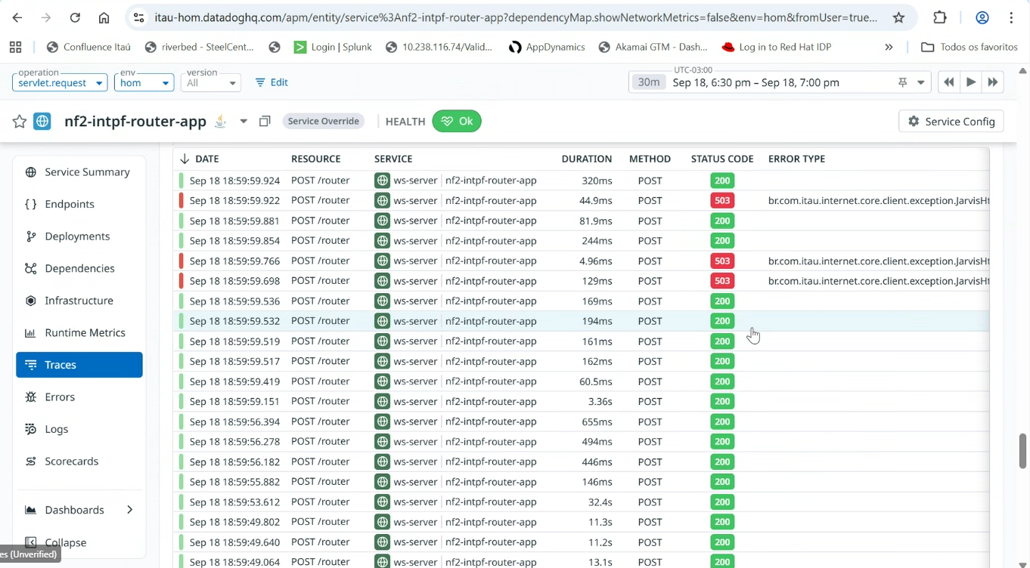
LIBERTY

Slide 3
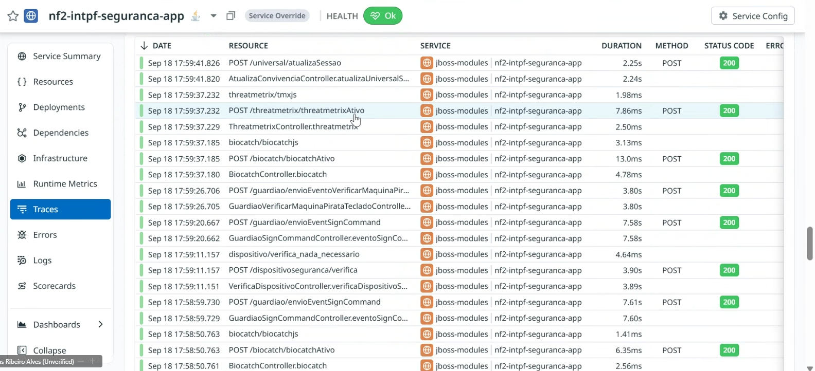
JBOSS

Slide 4
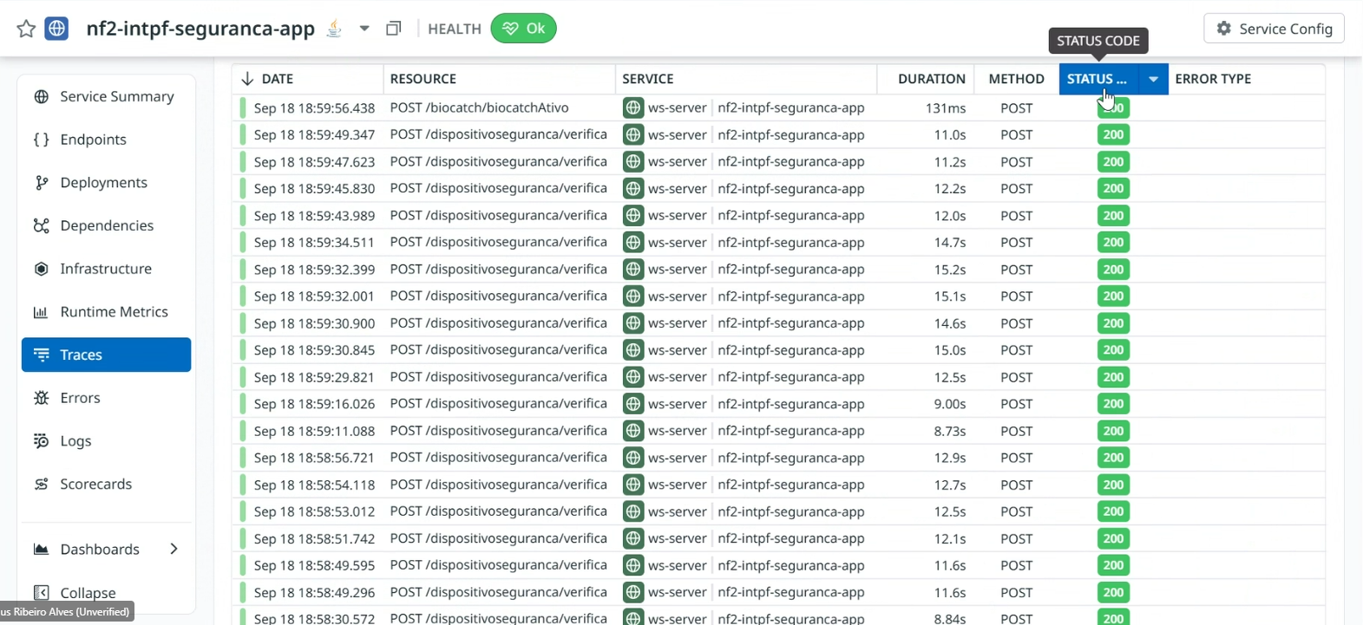
LIBERTY

Slide 5
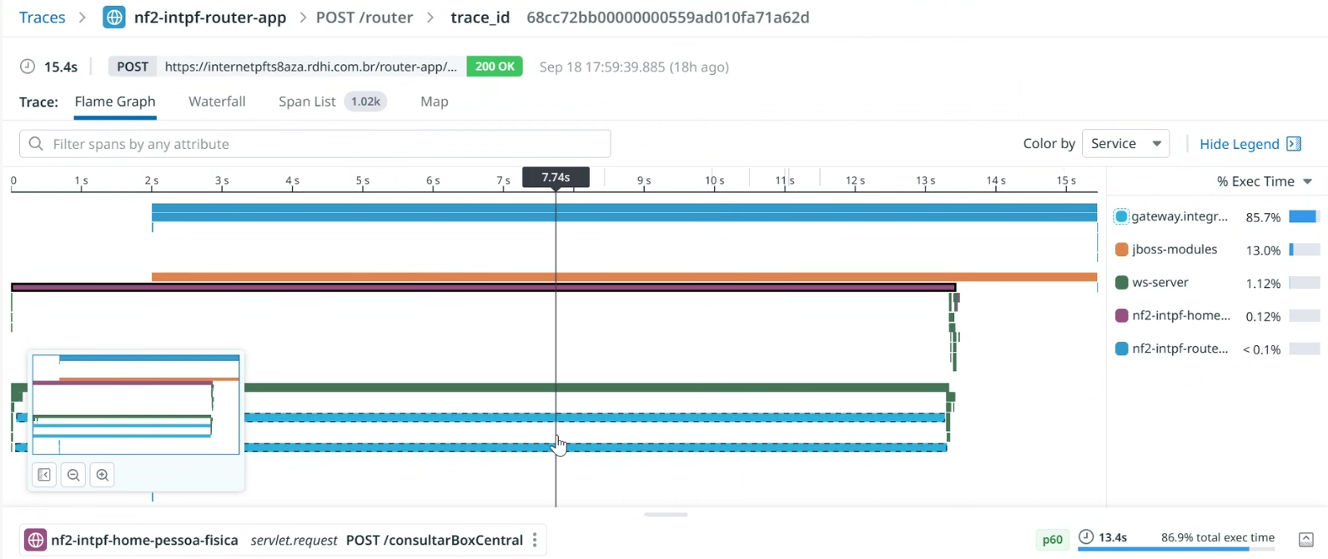

Slide 6
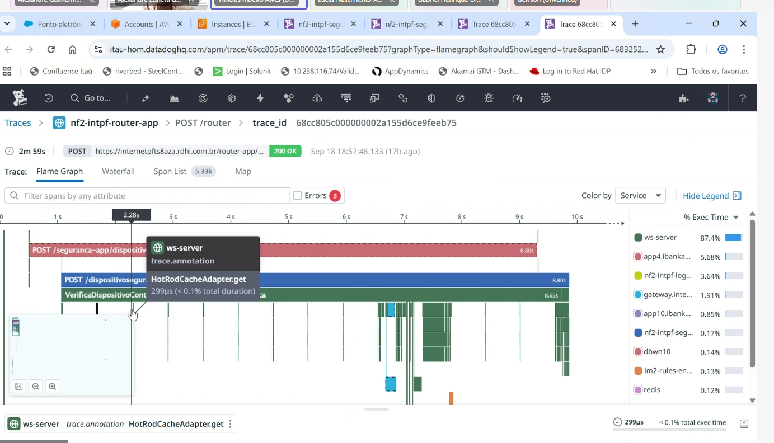
LIBERTY

Slide 7
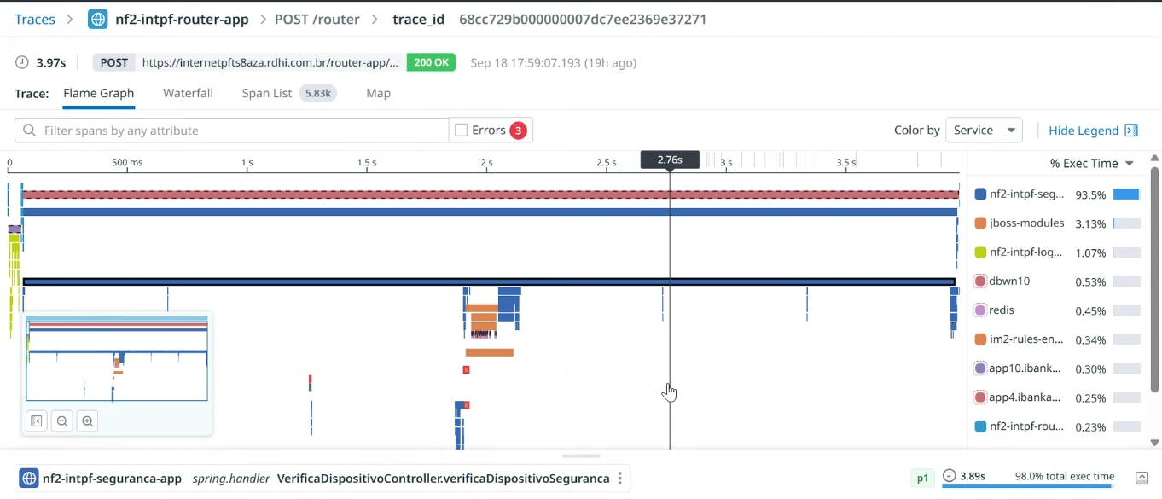
JBOSS

Slide 8
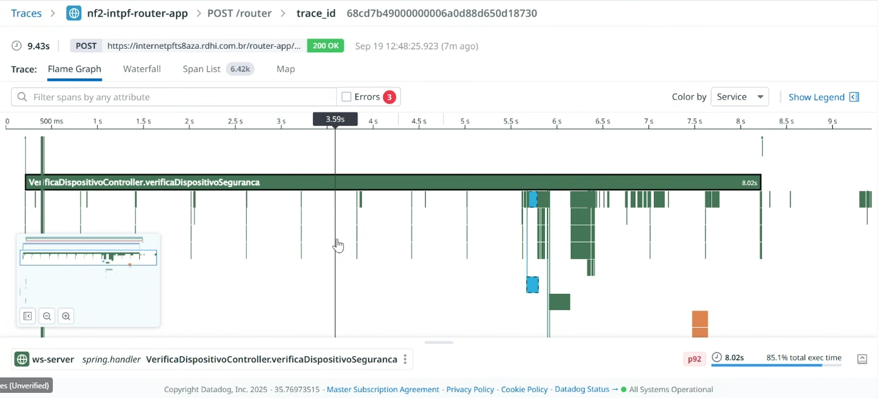
Novo teste de carga liberty – router

Slide 9
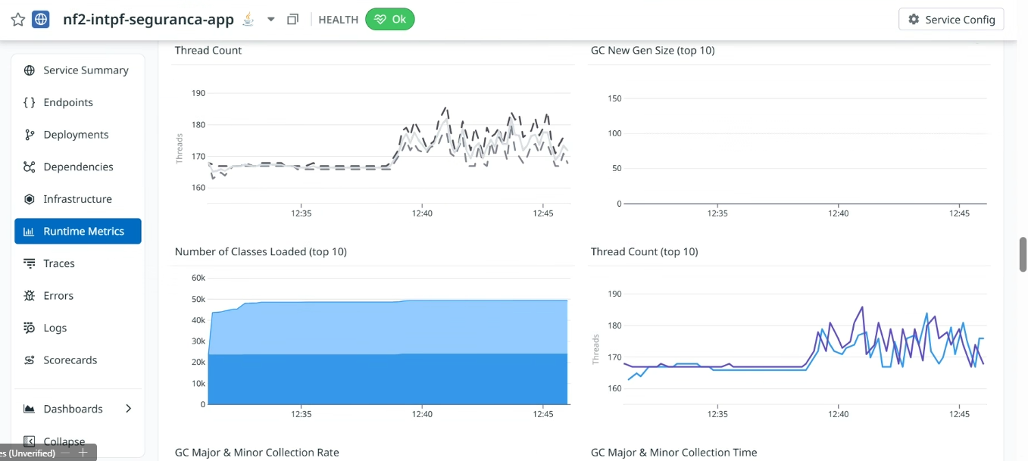
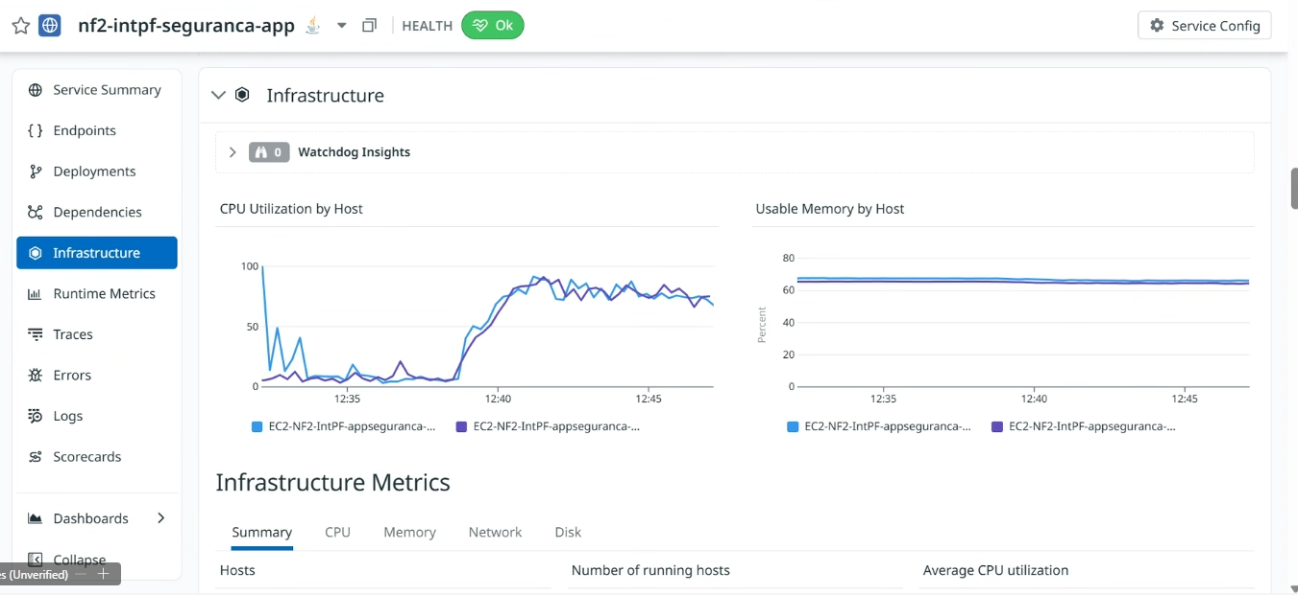
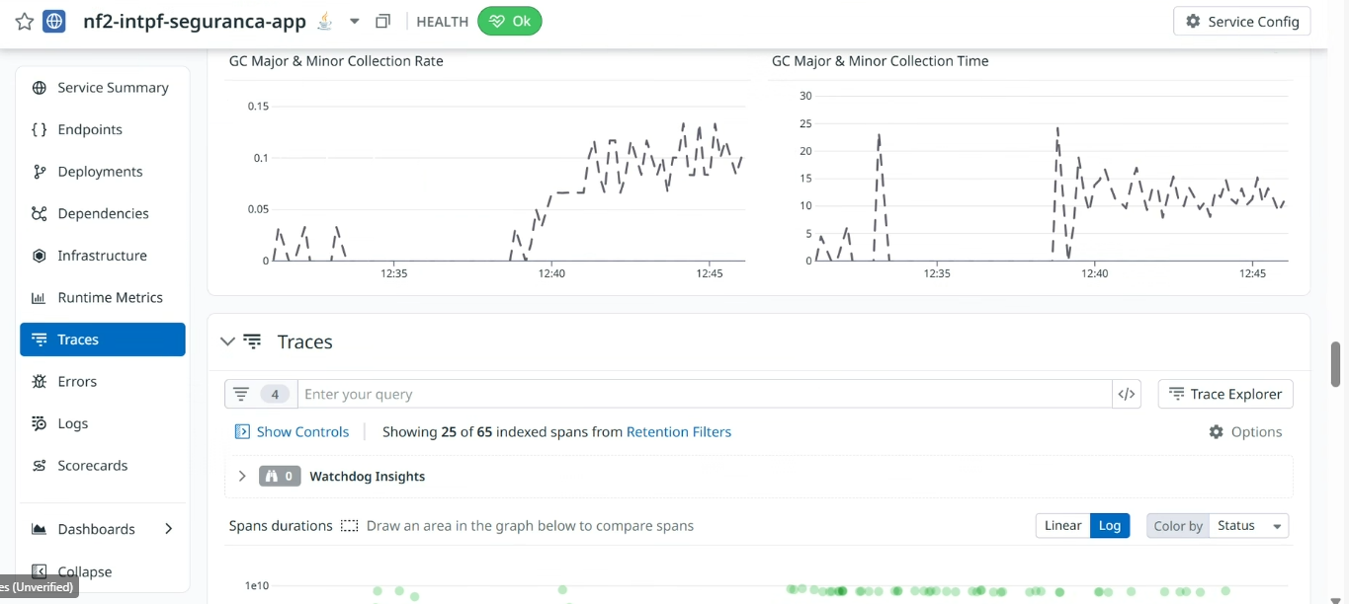
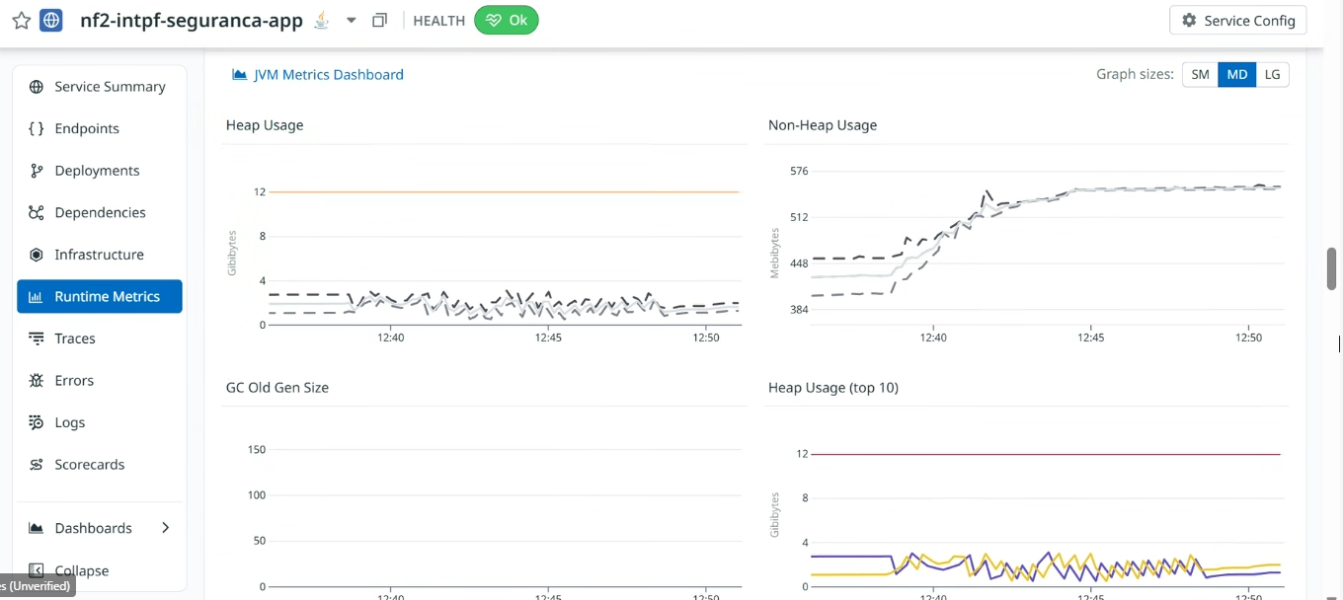
Novo teste de carga liberty - seguranca

Slide 10
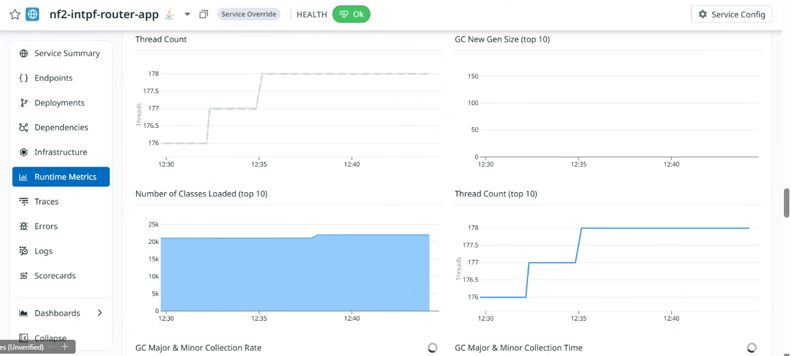
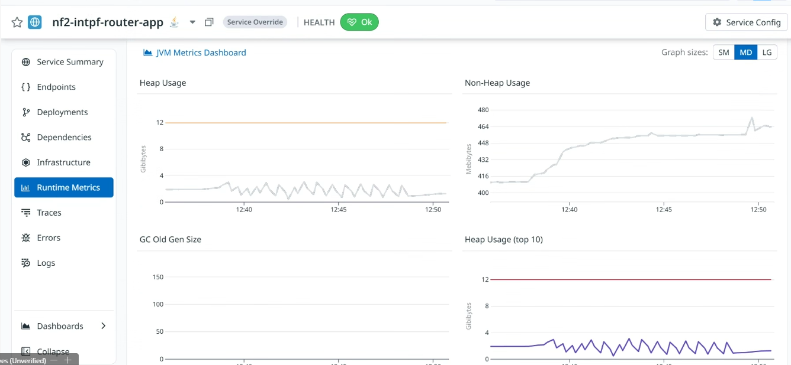
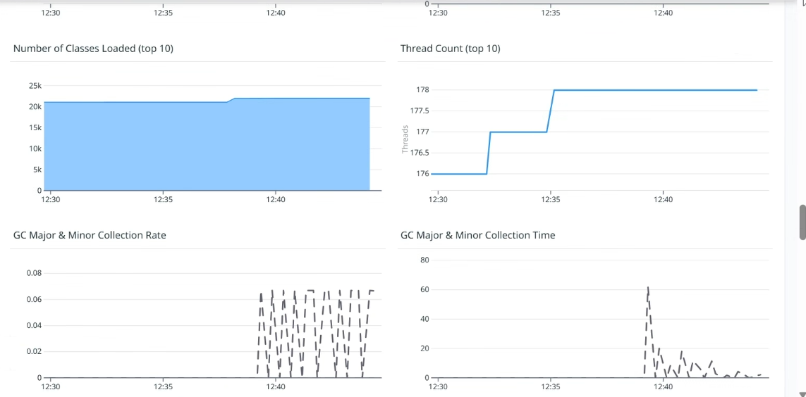
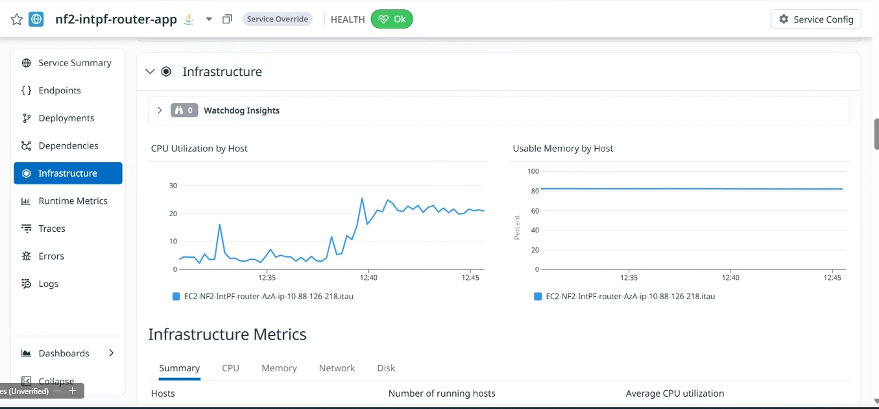
Novo teste de carga liberty - router

Slide 11
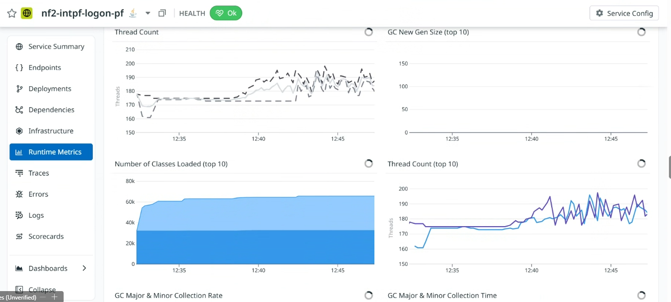
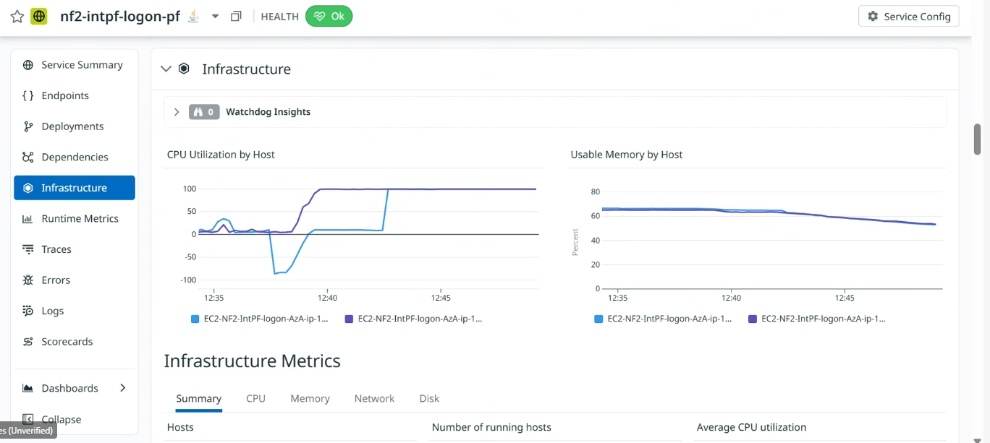
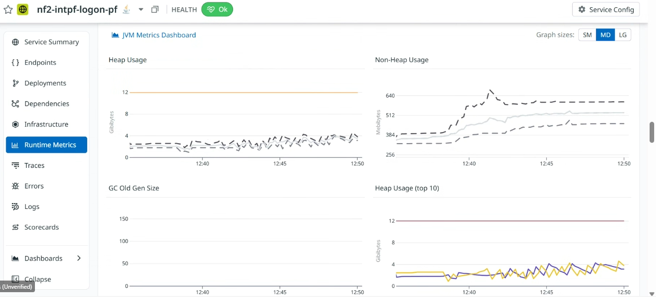
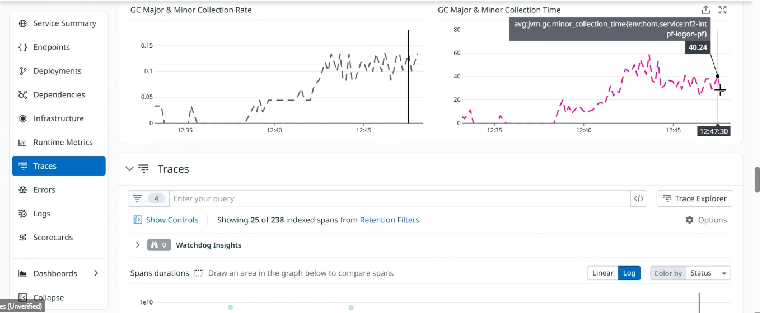
Novo teste de carga liberty - logon

Slide 12
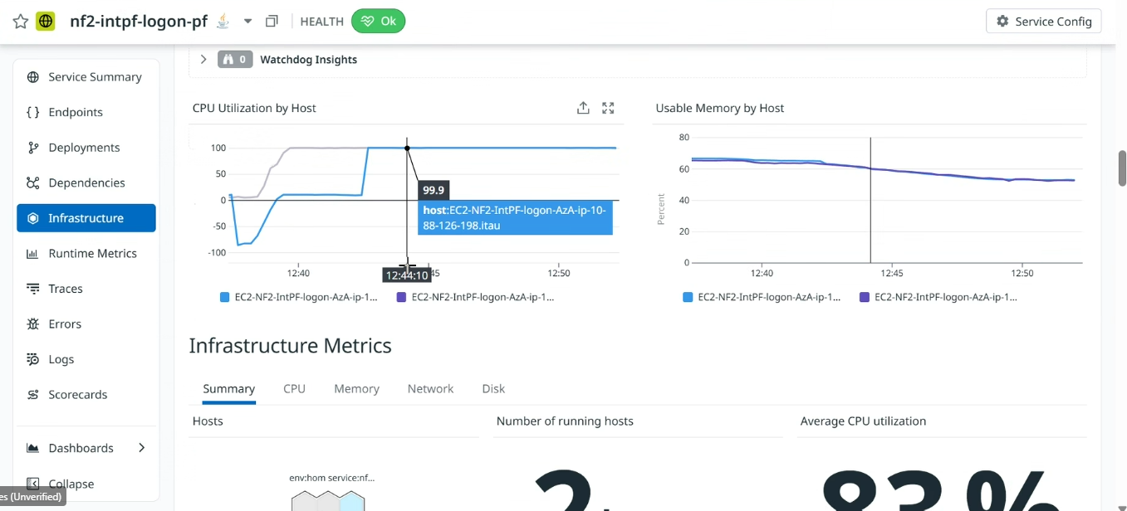
Novo teste de carga liberty – logon – pós teste com CPU ainda em 100%

Slide 13
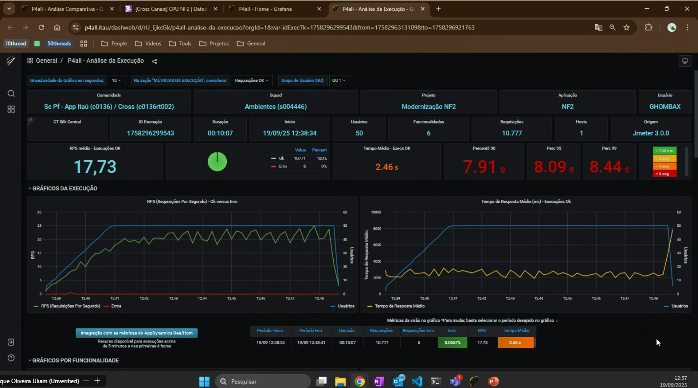
Novo teste de carga liberty – JMETER tempo total

Slide 14
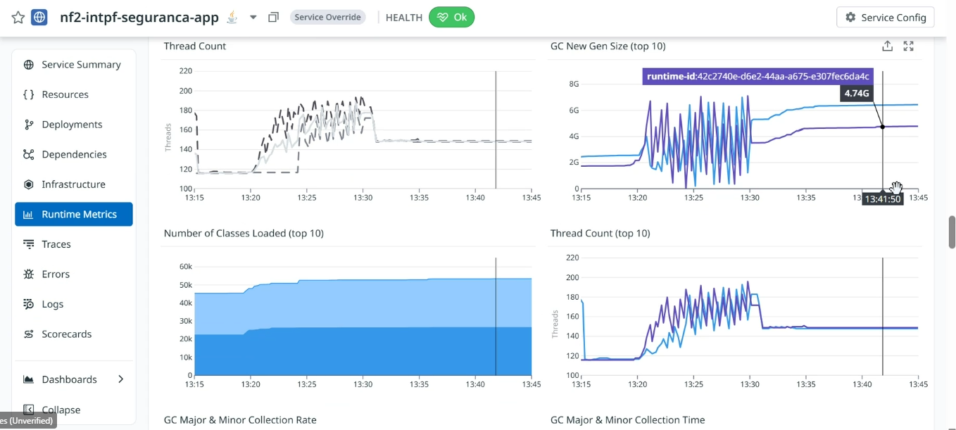
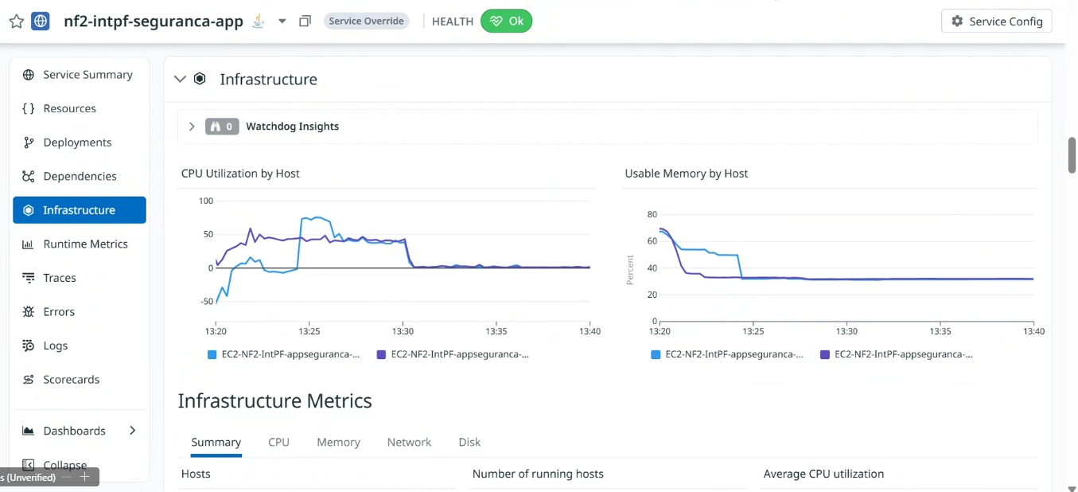
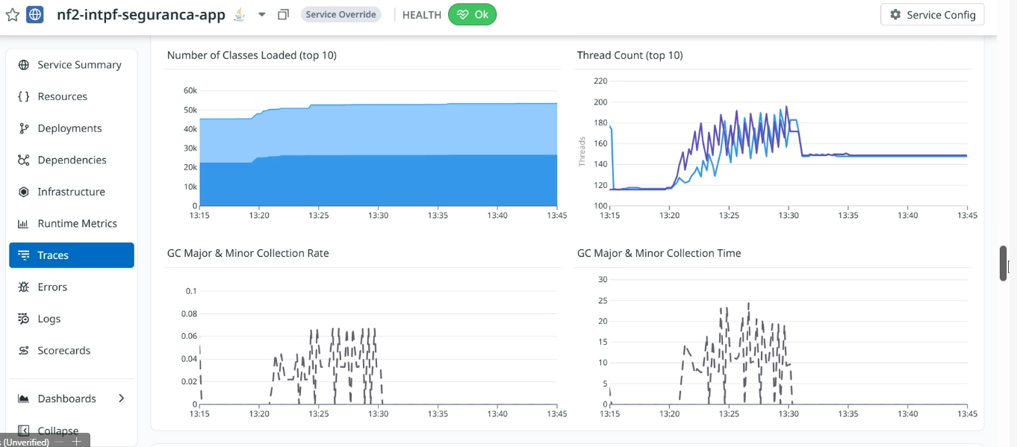
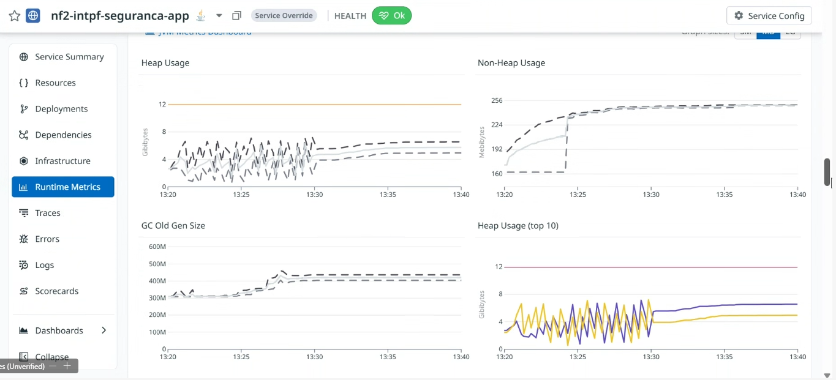
Novo teste de carga JBoss - seguranca

Slide 15
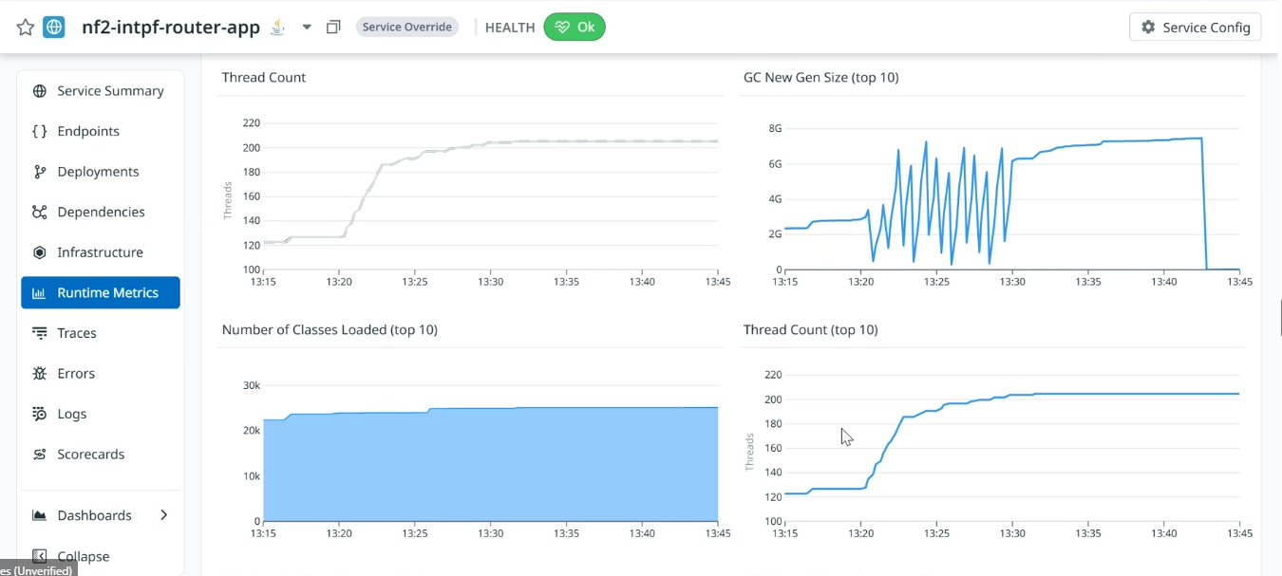
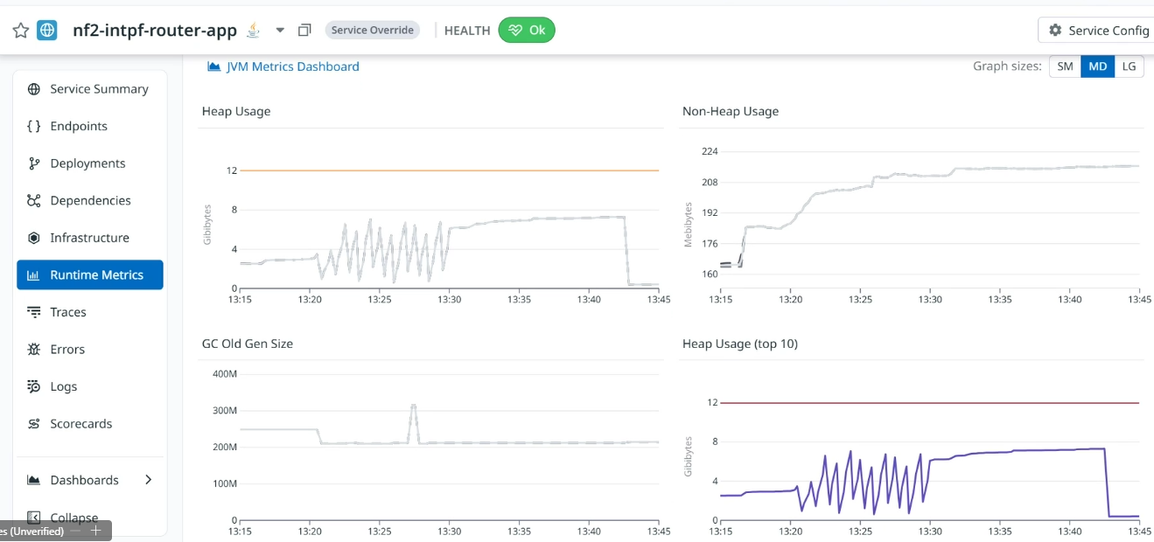
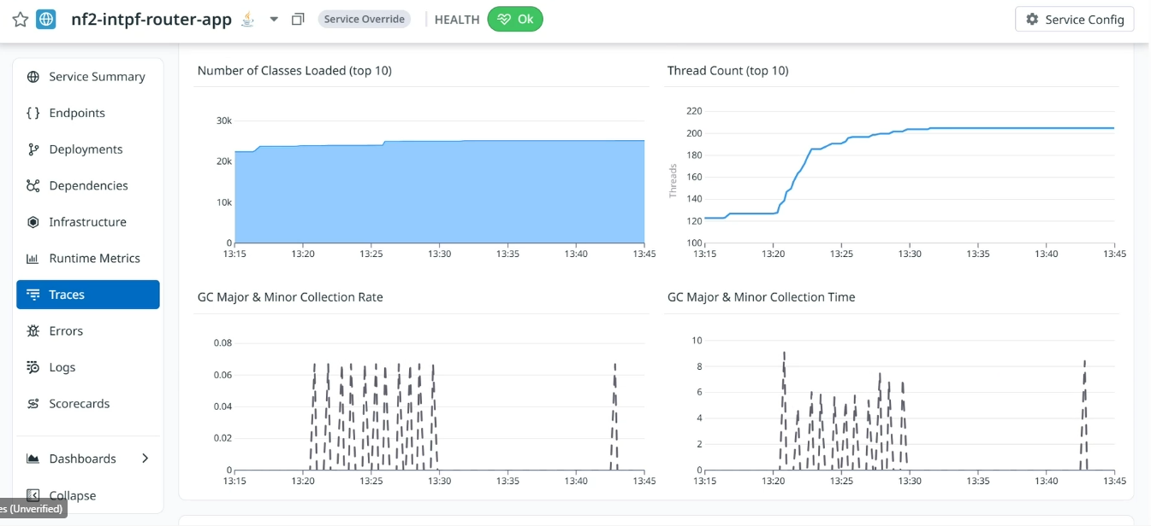
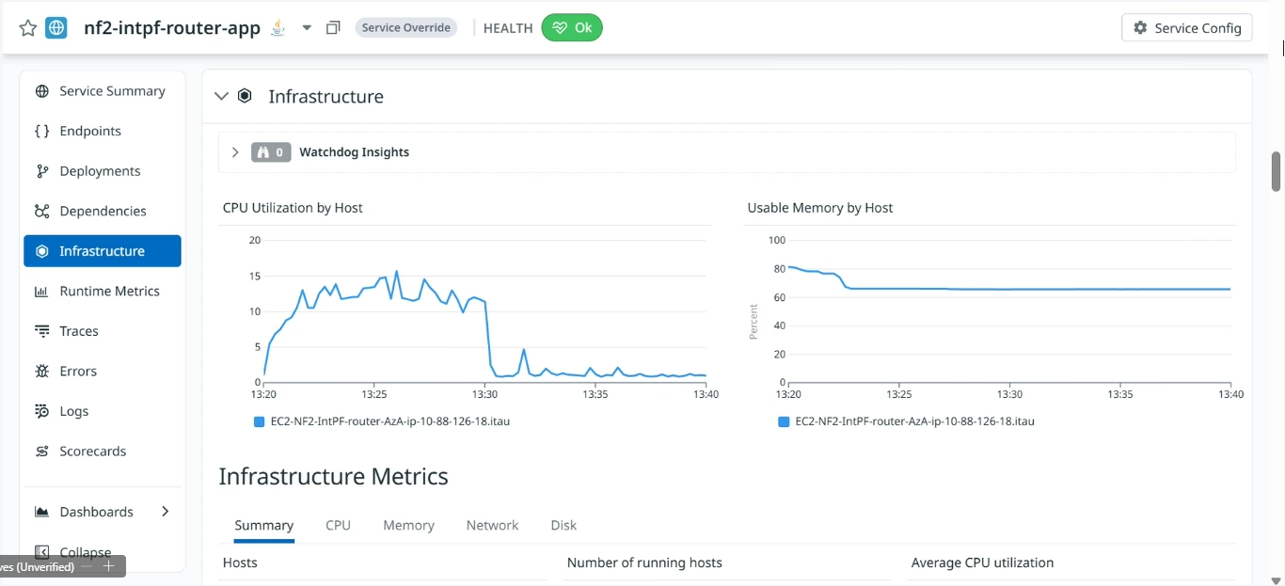
Novo teste de carga JBoss - router

Slide 16
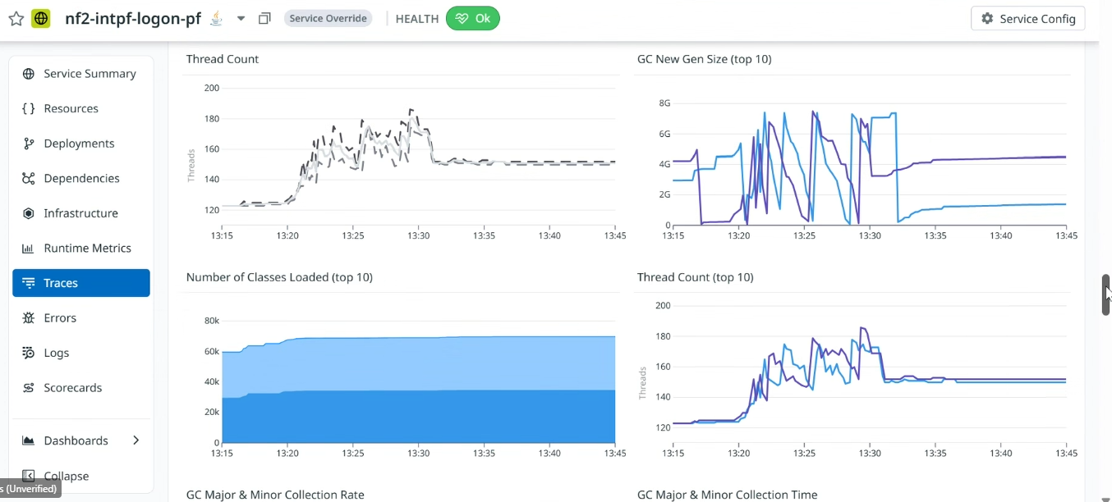
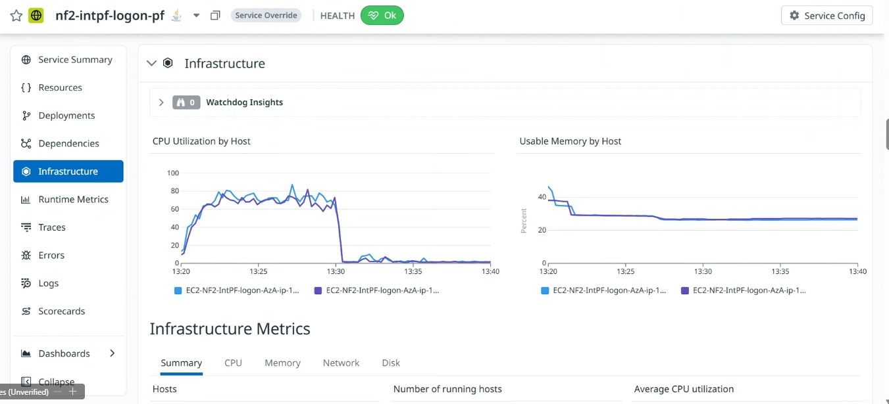
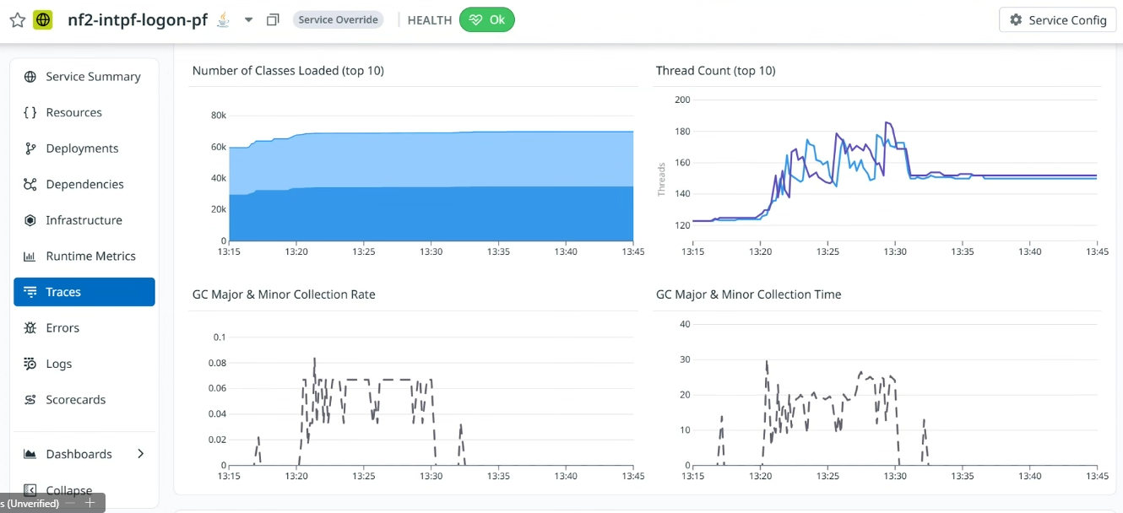
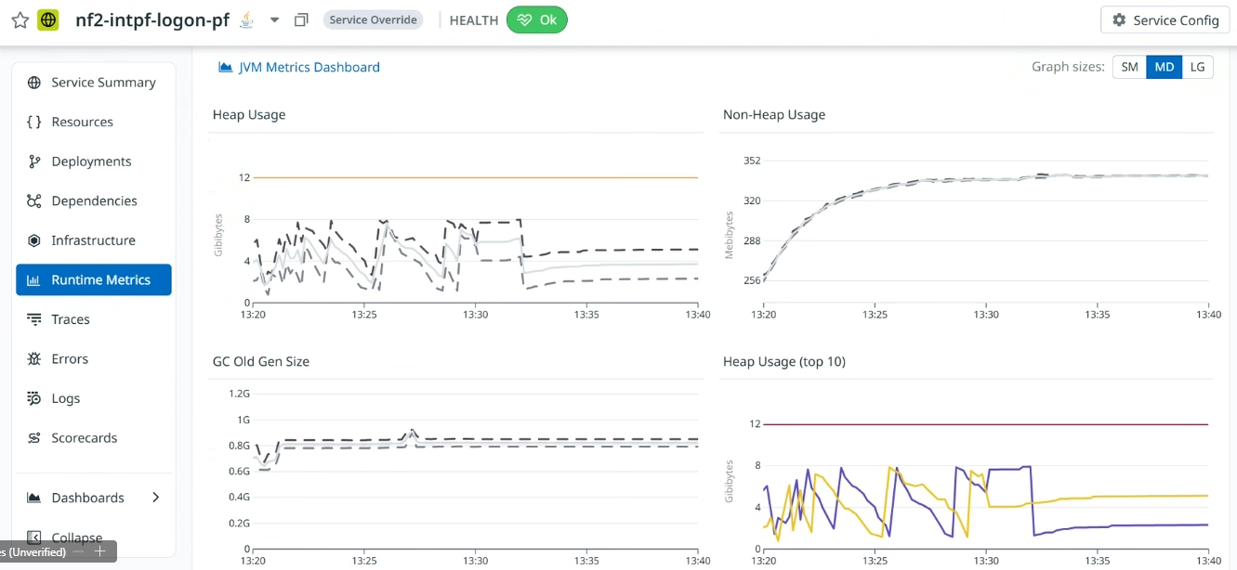
Novo teste de carga JBoss - logon

Slide 17
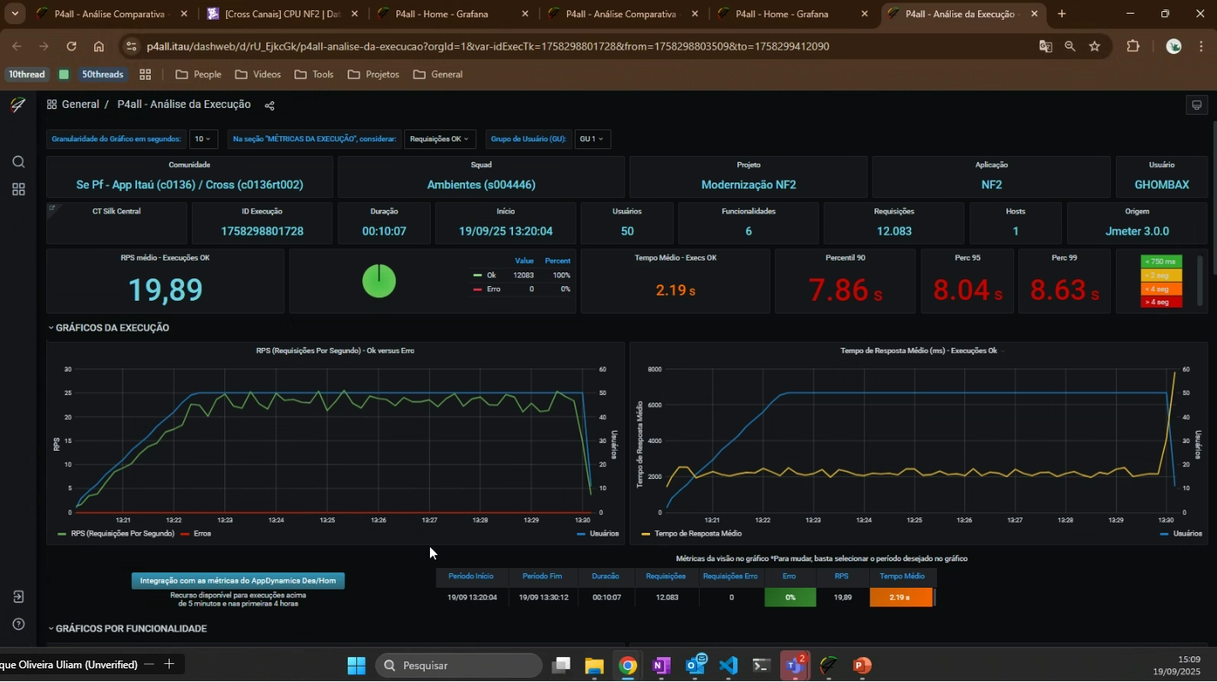
Novo teste de carga Jboss – JMETER tempo total

Slide 18
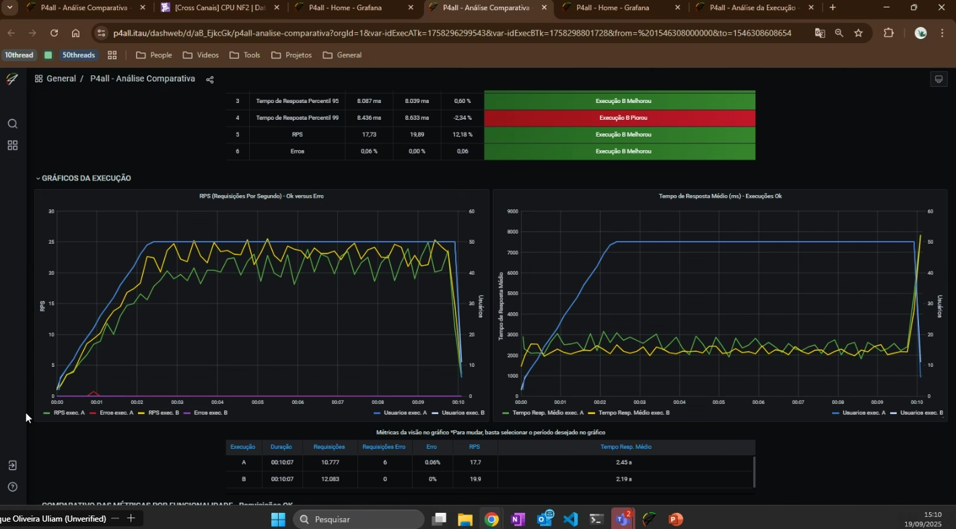
Novo teste de carga Jboss verde Liberty amarelo – JMETER comparativo

